Slide 1

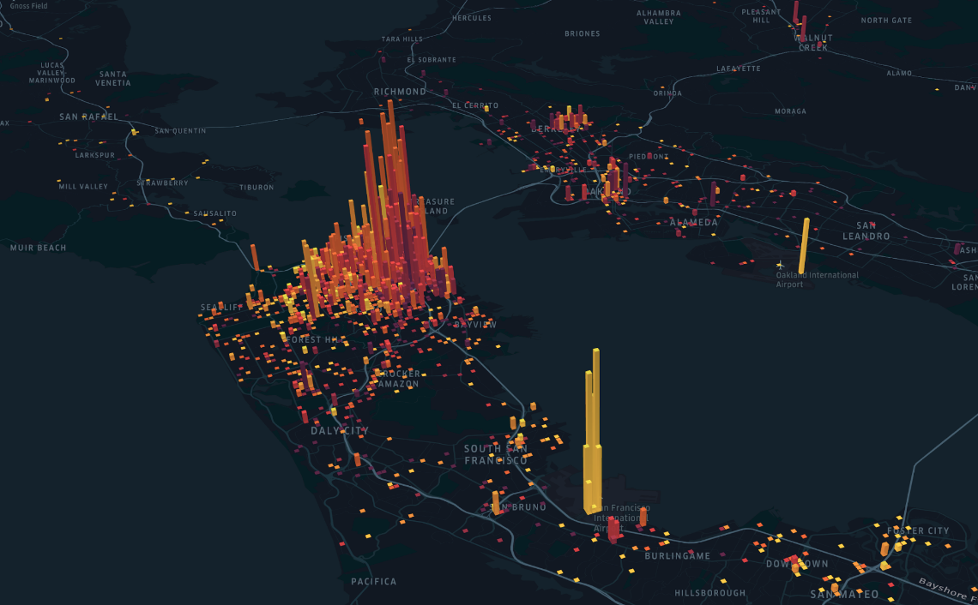
Target-Lite Locational Analysis
Dexter Corley

Slide 2
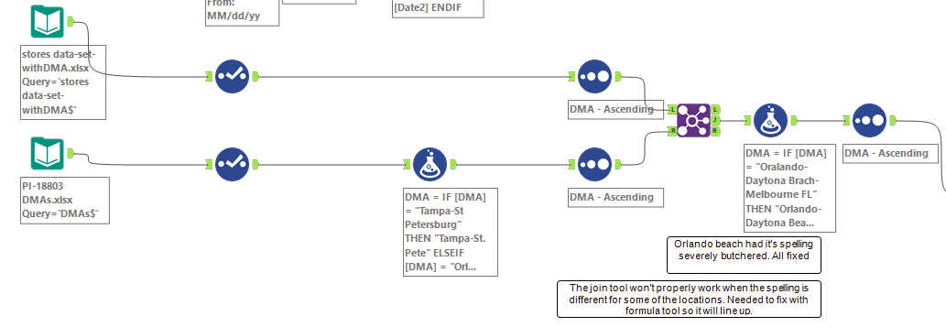
Data engineering: DMA sheets There were 4 DMA sheets provided that I planned on eventually overlapping in some capacity. This slide and the next will cover my thoughts & plans for each.
Stores data set with DMA: this contained the 45 stores tasked to analyze with their respective DMA (location).
Pi-18803 DMA’S: this data set contained 211 different DMA’s as well as statistics for each such as population, races, household income, etc. all of this information is perfect for conducting predictive models for store revenue. however, most of it is useless as we only have 15 locations with store revenue data. to get the store data i joined this with the store data set by DMA and dropped all the locations not needed.

Slide 3
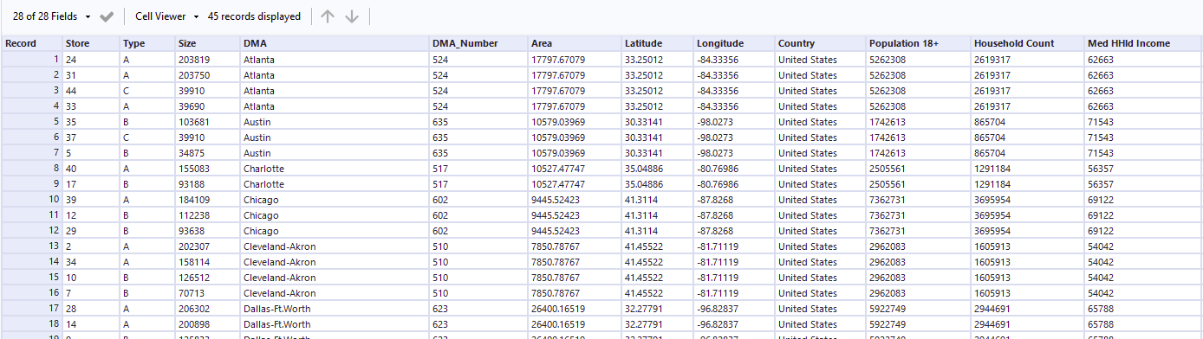
Resulting dataset

Slide 4
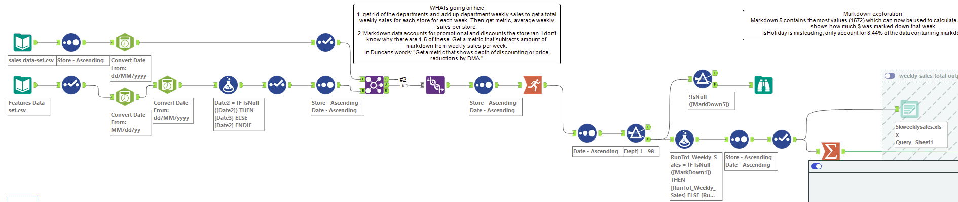
Data engineering: DMA sheets 2
Sales data set: This contains data on weekly sales per store, per department, for 3 years (2010-2012). After cleaning up the date/time formatting I realized Department data doesn’t matter. I was after weekly sales data per store. Combing through it and thinking how to arrive there, I realized each store has 98 departments except a few that have 99. I created a new column, used the running total tool which added up each departments sales per week until it got to 98. Then using a filter, I removed every stores department except for the 98th one. This also helps to remove duplicate markdowns as they're store wide not department specific.
Features data set: This contains weekly data for each store like temperature, CPI(didn’t end up using), fuel price, markdown amounts, and whether the week fell on a holiday. This dataset was joined with the sales dataset by date.
For Lin
reg
model
Summary

Slide 5
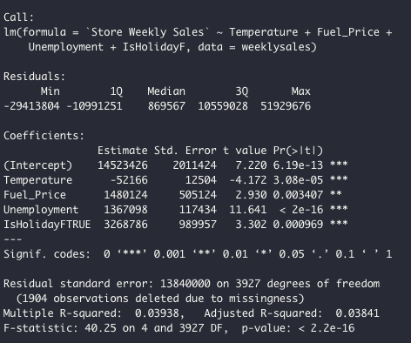
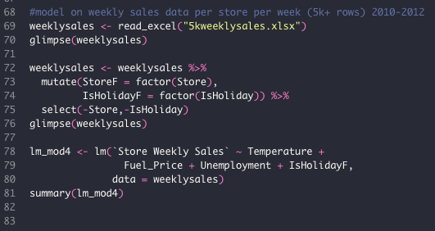
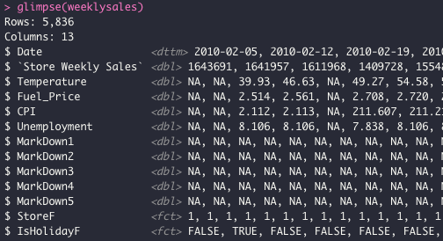
Linear regression: sales data set with per week revenue by store (no departments)
This regression model performed quite bad as the R^2 was 0.03.
With that, each of the predictor variables earned low p-values and provide some insight into what drives or lowers sales on a given week. Among the obvious being a huge increase to sales when there’s a holiday.
I ran some models on the other DMA datasets, but they performed much worse and gave no good insights worth mentioning.

Slide 6
Accounting for markdown
At first, I didn’t know what the markdown fields represented. However, I concluded they stood for the number of sales discounted for that week.
In my analysis I treated it as such and created a formula subtracting the total markdowns from the sales for that week when they happened.
I thought a lot about how I would go down the path of analyzing which store makes the most when they have markdowns or which store loses the most, etc. But I felt like it was more appropriate to address the store as a whole rather than just in holiday times.

Slide 7
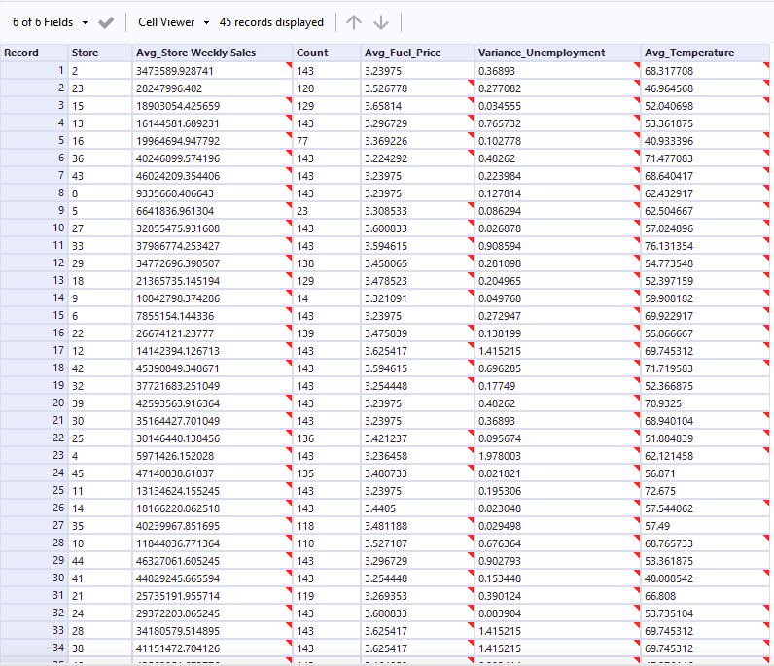
Data engineering: DMA sheets 2 continued
Once the data streamed into the summarize after having the total per week store sales. The result is per store average weekly sales, average fuel, variance of unemployment, and average temperature. These other datapoints I was hoping would later give some insights, but nothing contributed much
*the red corner on the cells are notifying that the decimal place was round to 6 places for “clarity”

Slide 8
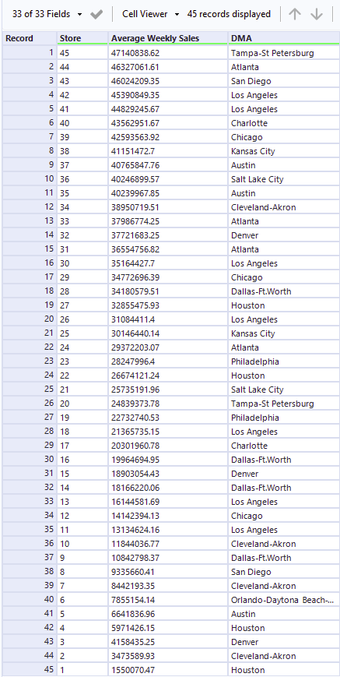
Average weekly sales: comment
After getting the scores for average weekly sales by store, something weird that I noticed is that the stores with the highest average sales are in descending order by their store number. On top of that, this shows how some stores may be in the same area, yet they make have either a much larger or smaller weekly average sales.
Relating back to the question, these circumstances, like Tampa, show that one of one of the stores has nearly double the market share than the other. Which is a good opportunity to pick that store and shave off some of the pie for our target-lite. The only issue there is that there is not accurate locational data per store, just by DMA.

Slide 9
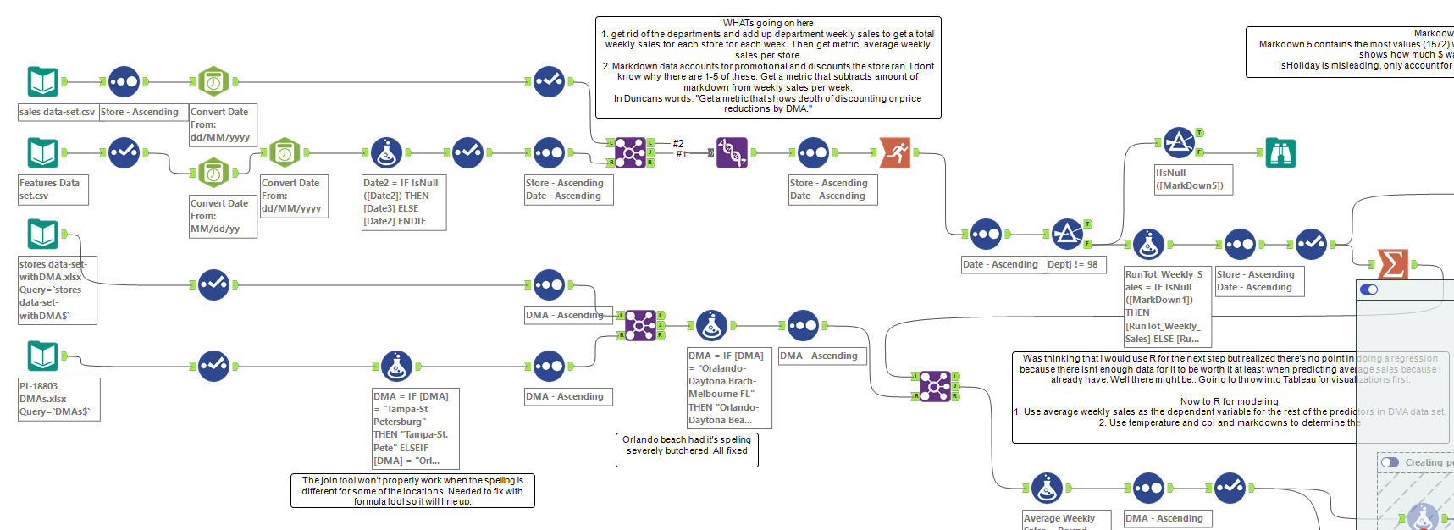
Workflow:

Slide 10
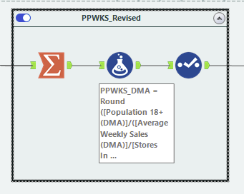
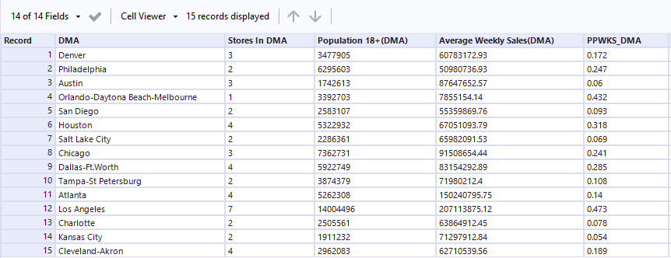
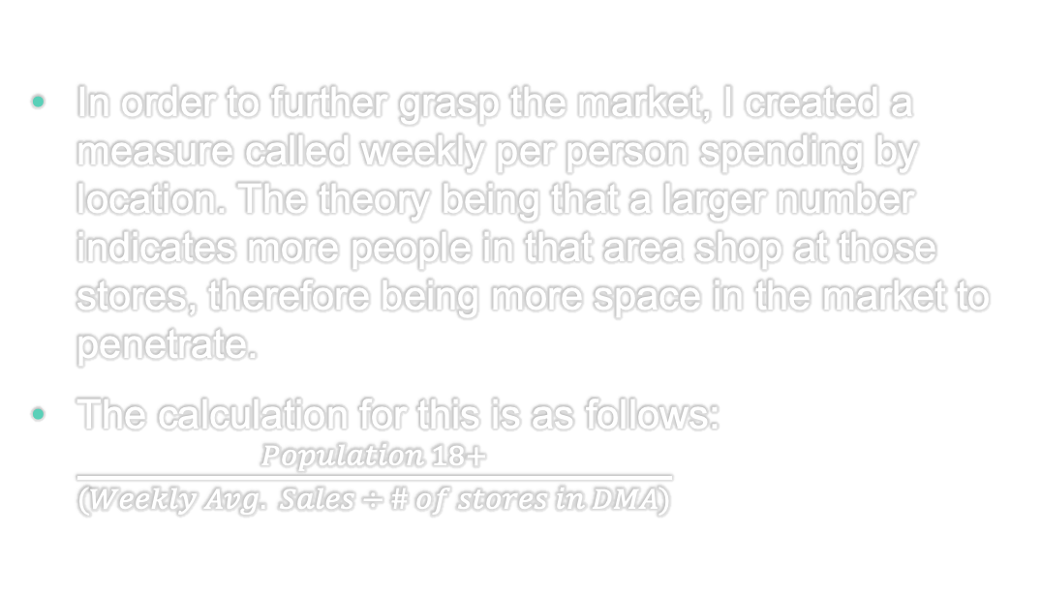
Weekly per person spending by location
In order to further grasp the market, I created a measure called weekly per person spending by location. The theory being that a larger number indicates more people in that area shop at those stores, therefore being more space in the market to penetrate.
The calculation for this is as follows: $\frac{Population 18+}{(Weekly Avg. Sales ÷ \# of stores in DMA)}$
RESULTS

Slide 11
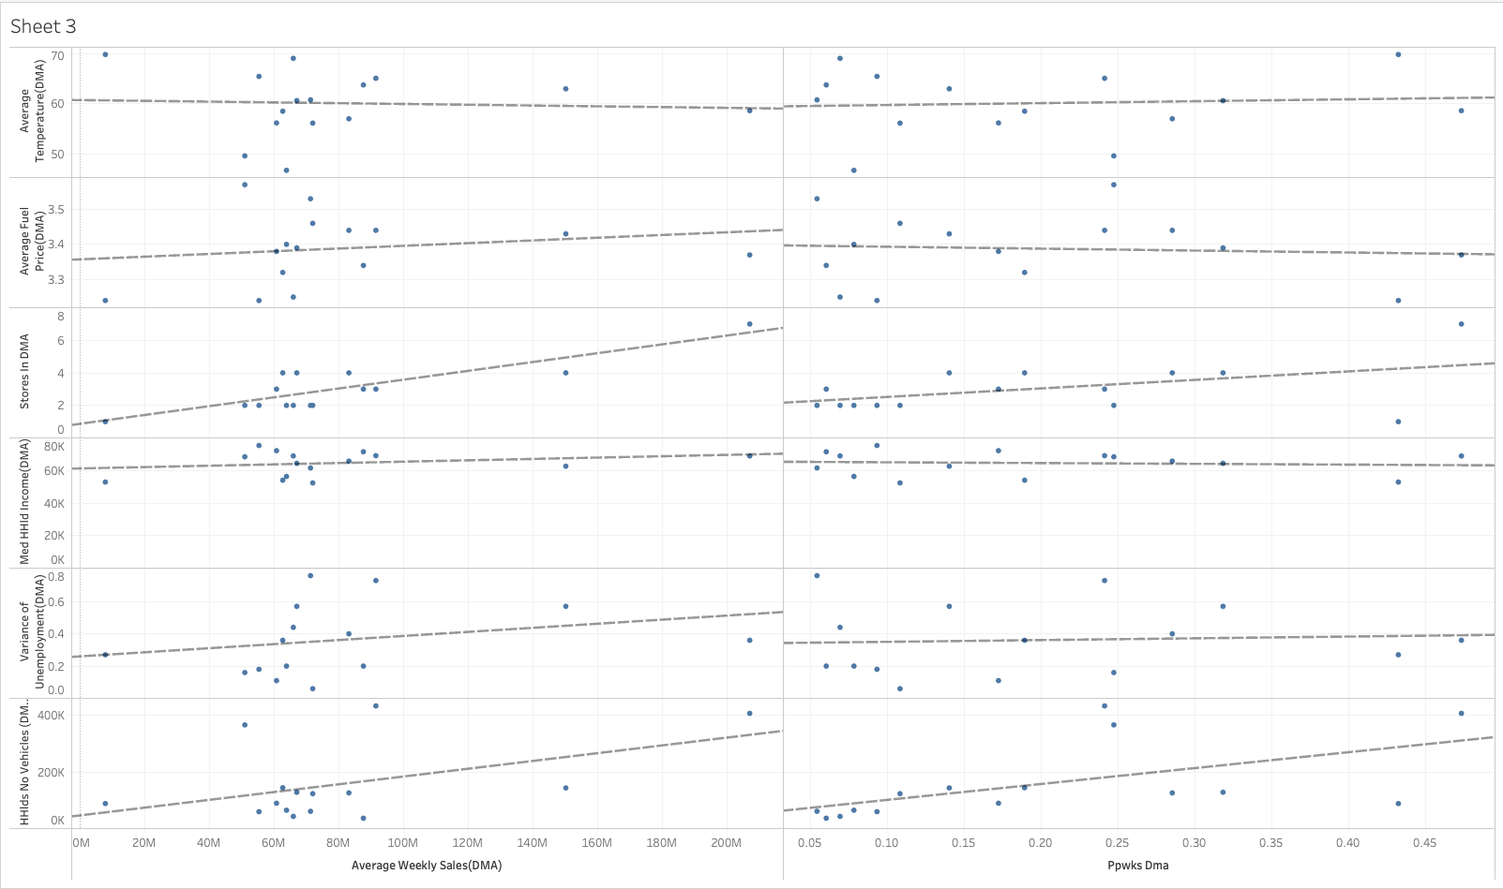
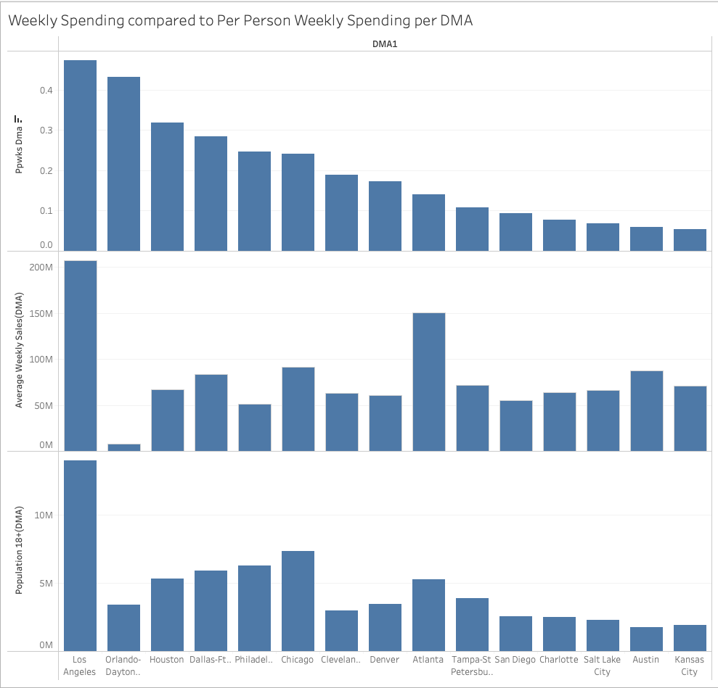
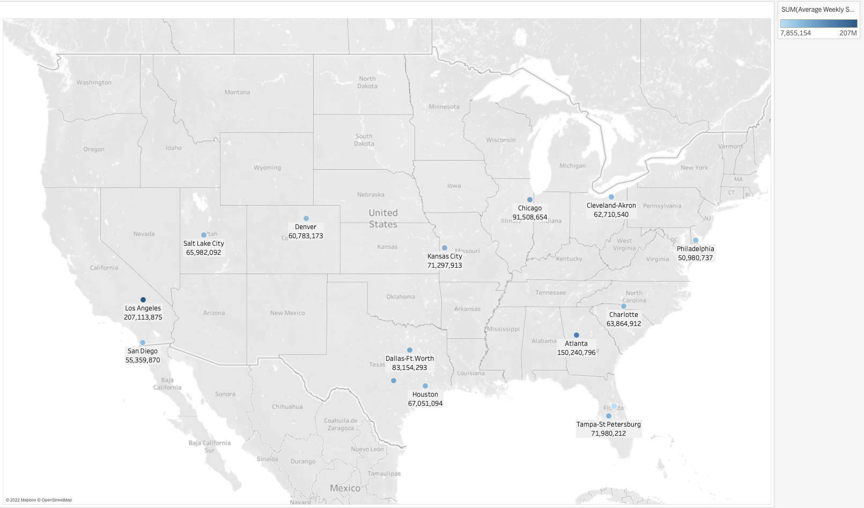
Visualizations
I did this visualization to see the relationships between sales and some of the other variables in the dataset like temperature, fuel price, # of stores, household income, etc. The only relationship that was statistically was with stores, however, this is skewed because the sales were added together with the other stores which makes this relationship insignificant.
This last visualization would be great in a presentation with management but doesn’t give much new info. I wanted to make use of the Long. Lat. Data points so this map shows each DMA color coordinated to cumulative sales.
PPWKS(Per Person Weekly Spending)
The above bar graphs shows the relationship between DMA and population, sales, and weekly per person spending. LA having the highest average weekly per person spending as well as highest total cumulative store sales suggests that there may be room for multiple locations here. Another stand out from this graph shows Orlando at second highest PPWKS however the lowest cumulative weekly revenue at only 1 store suggests it has a large percentage of the market which leaves room for us.

Slide 12
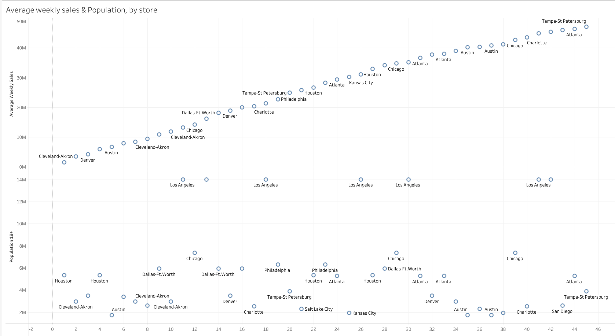
Visualizations cont.
These scatter plots show the weekly average sales and populations per store. What stands out here is Tampa, Atlanta, and San Diego, the spread in sales between locations as well as the low population screams a market opportunity.

Slide 13
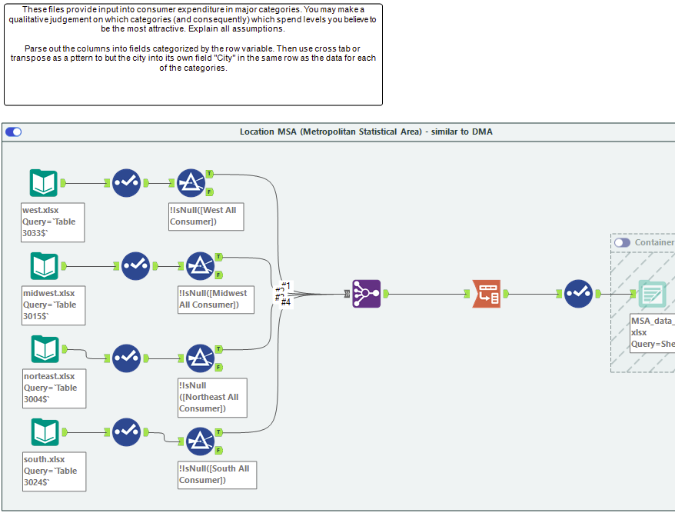
Data Engineering for MSA Sheets
The MSA data was relatively straight forward in the process of joining by category. I removed the null values and headers that led to blank rows then output the data to an excel file with the intention of using it to find some helpful insights…

Slide 14
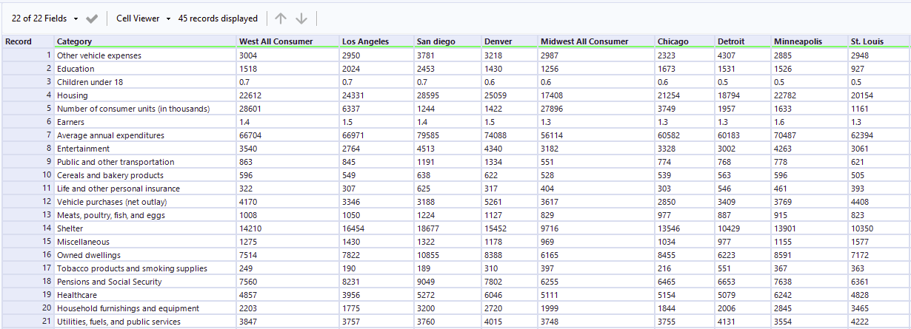
MSA Combined datasheet

Slide 15
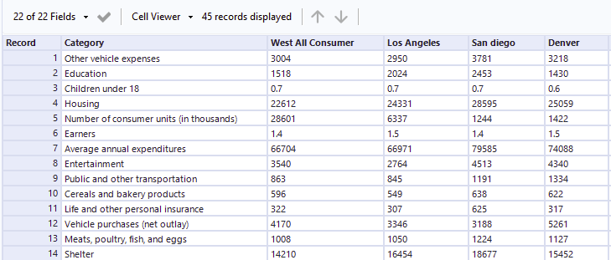
Other MSA dataset ideas
My goal was to switch the category field to be column headers and locations to be rows. I couldn’t get to a point where this would work. The idea was to join this dataset with weekly average sales and use some of the category fields as predictor variables.

Slide 16
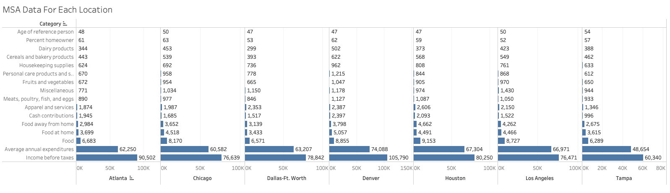
MsA dataset visualization
This dataset didn’t include all the DMA locations, however with the ones it did provide some useful takeaways. For example, reaffirming Houston and Los Angeles as good markets as they had the top two food totals as well as food away from home expenditures. The other standout being Denver as they came in at the highest income before taxes, annual expenditures, and 3rd highest spent on food.

Slide 17
Results: 3 key takeaways
The weekly per person spending by location (PPWKS) is a good metric to use for determining markets with more space to join. However, using this and nothing else would land Orlando the second spot while they have the lowest per store revenue. Additionally, another purpose of this metric is to determine where the people in this area shopping. High PPWKS score shows more people spending money at the stores in that DMA.
*In hindsight, taking PPWKS scores for each year would have been a great way to forecast market growth.
2. Weekly average revenue by location and by store. The locational sum of weekly revenue gives us the current average weekly market size in each DMA. This is helpful in determining where our stores have the potential to the make the most money, and therefore should be weighted heavily in the final decision. The problem with going right down the list 1-10 highest earning locations is that you might miss out on markets like store 45 in Tampa. Pairing the locational sales with sales by store shows these gaps (slide 12).
3. The last thing to base judgement on for our final list is taking the MSA data results into account with the locations’ average income, expenditures, and amount spent on food.

Slide 18
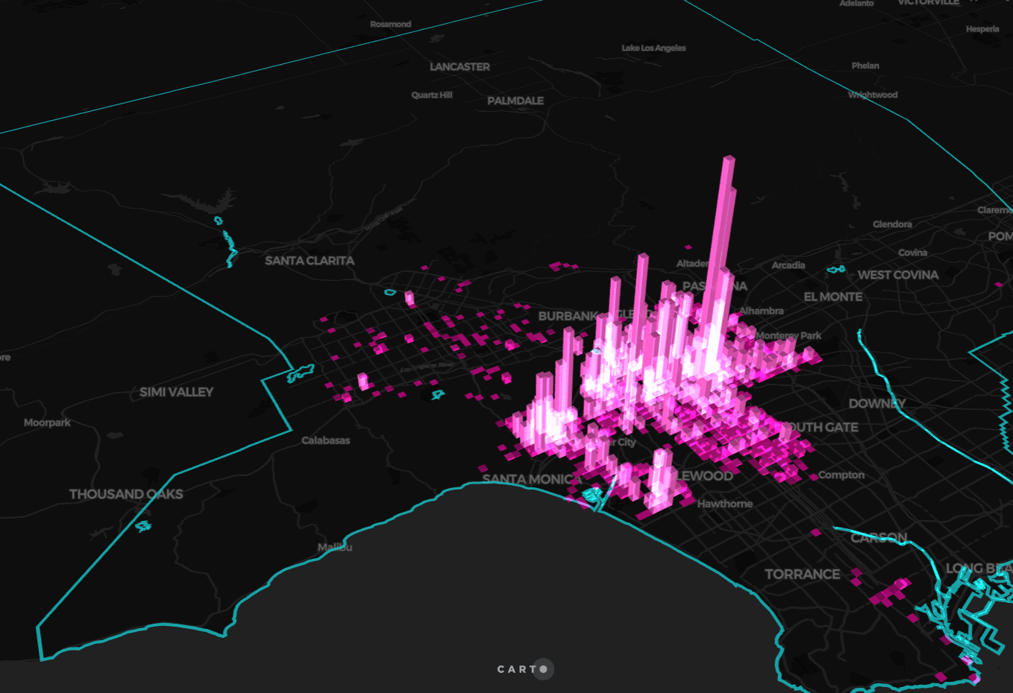
Conclusion
Los Angeles
Los Angeles
Tampa (close to store 45)
San Diego
Atlanta
Denver
Dallas Ft. Worth
Houston
Philadelphia
Chicago
The final list takes all the quantitative and qualitative results of this analysis into account. Beginning at number 1: Los Angeles. This location held almost the highest metric for any measure these locations went through. It doubled any other population, except for Atlanta doubled any other DMA’s average sales and had the highest PPWKS score. This indicates that the market has a lot of space to fill and therefore warrants two store locations here. Next, the highest per store weekly average sales title goes to store 45 in Tampa St. Petersburg. While there are 2 stores in Tampa, this location more than doubled their sales. There possibly being a higher concentration of the city’s population closer to store 45 and in need of an alternative location. Location umber 3 goes to San Diego. This location wasn’t a big stand out in many of the categories but needs a new store on the same premise as Tampa (slide 8 shows avg sales by store). Next on the list is Atlanta. Like LA, Atlanta makes a lot of money. They earned second place for locational average weekly sales and store 44 in ATL was second on sales average per week. The next spot at number 5 is Denver. According to the MSA dataset Denver contains the highest earning population and third highest total food expenditures. This city also has a good PPWKS score and weekly average sales. Next, Dallas Ft. Worth, Houston, Philadelphia, and Chicago are all on the list for the same reasoning. After choosing the first 6 locations, the remaining all have similar average weekly sales so the next thing to weigh in deciding locations for the future stores is PPWKS scores. As higher PPWKS scores indicate more people in the area shopping at those stores, we can assume a large, growing market. For these last locations they all had the next highest PPWKS and are ranked by weekly sales.

